Slide 1
HW4
Create rotation plot for slide 17 in SVM.
Do SVM on your data of choice.
Xuxin Yi Ziyue Qin

Slide 2
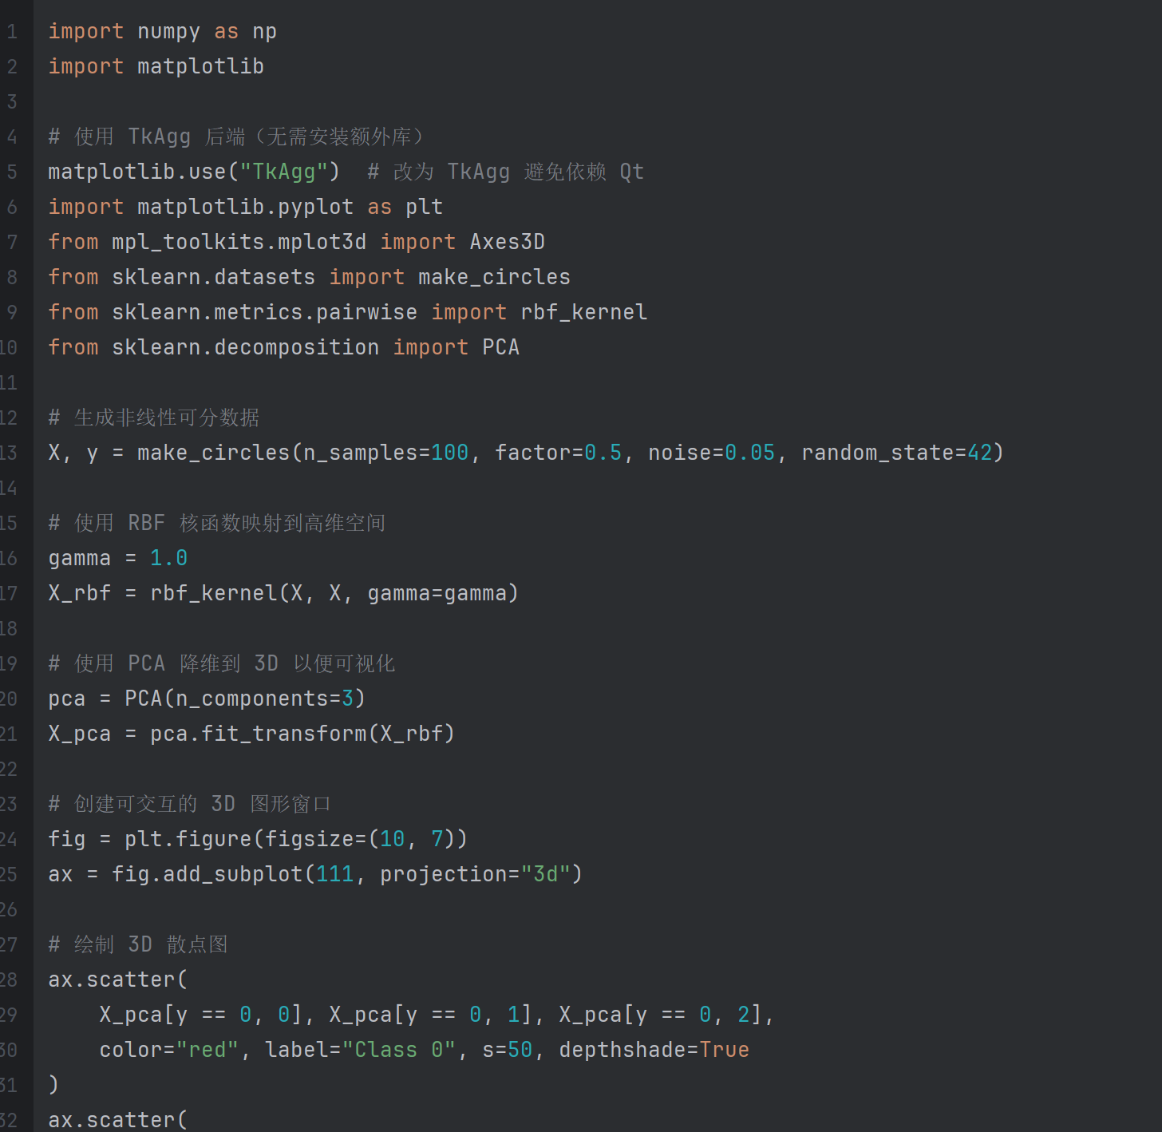
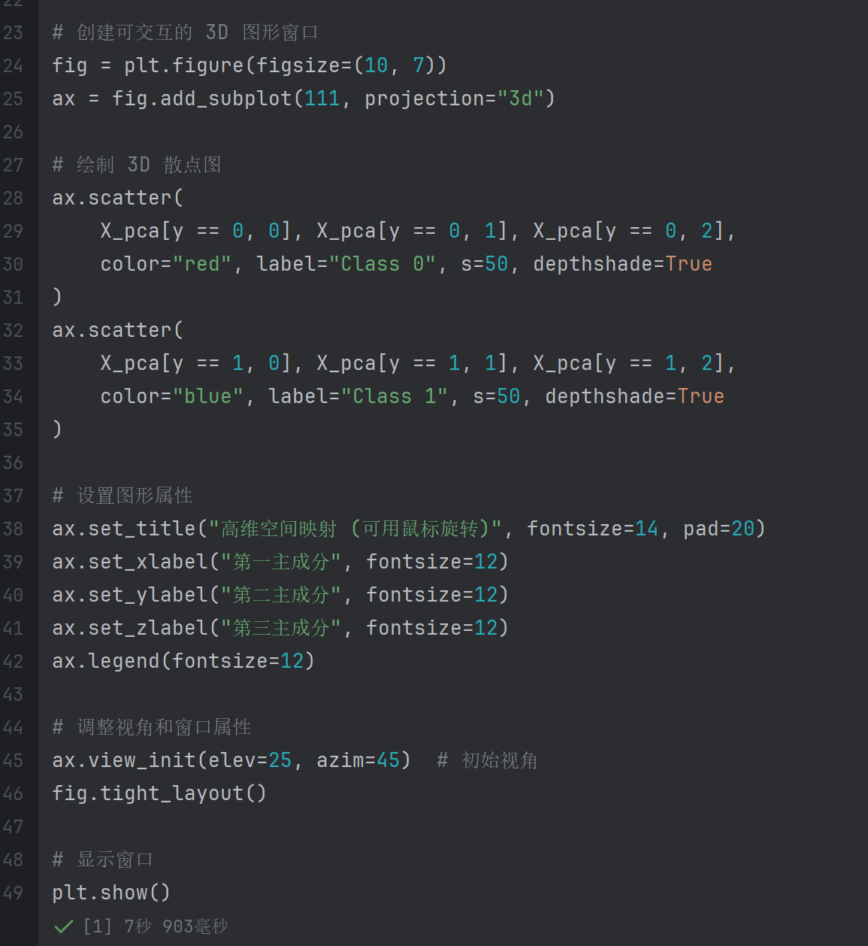
Create rotation plot for slide 17 in SVM.

Slide 3
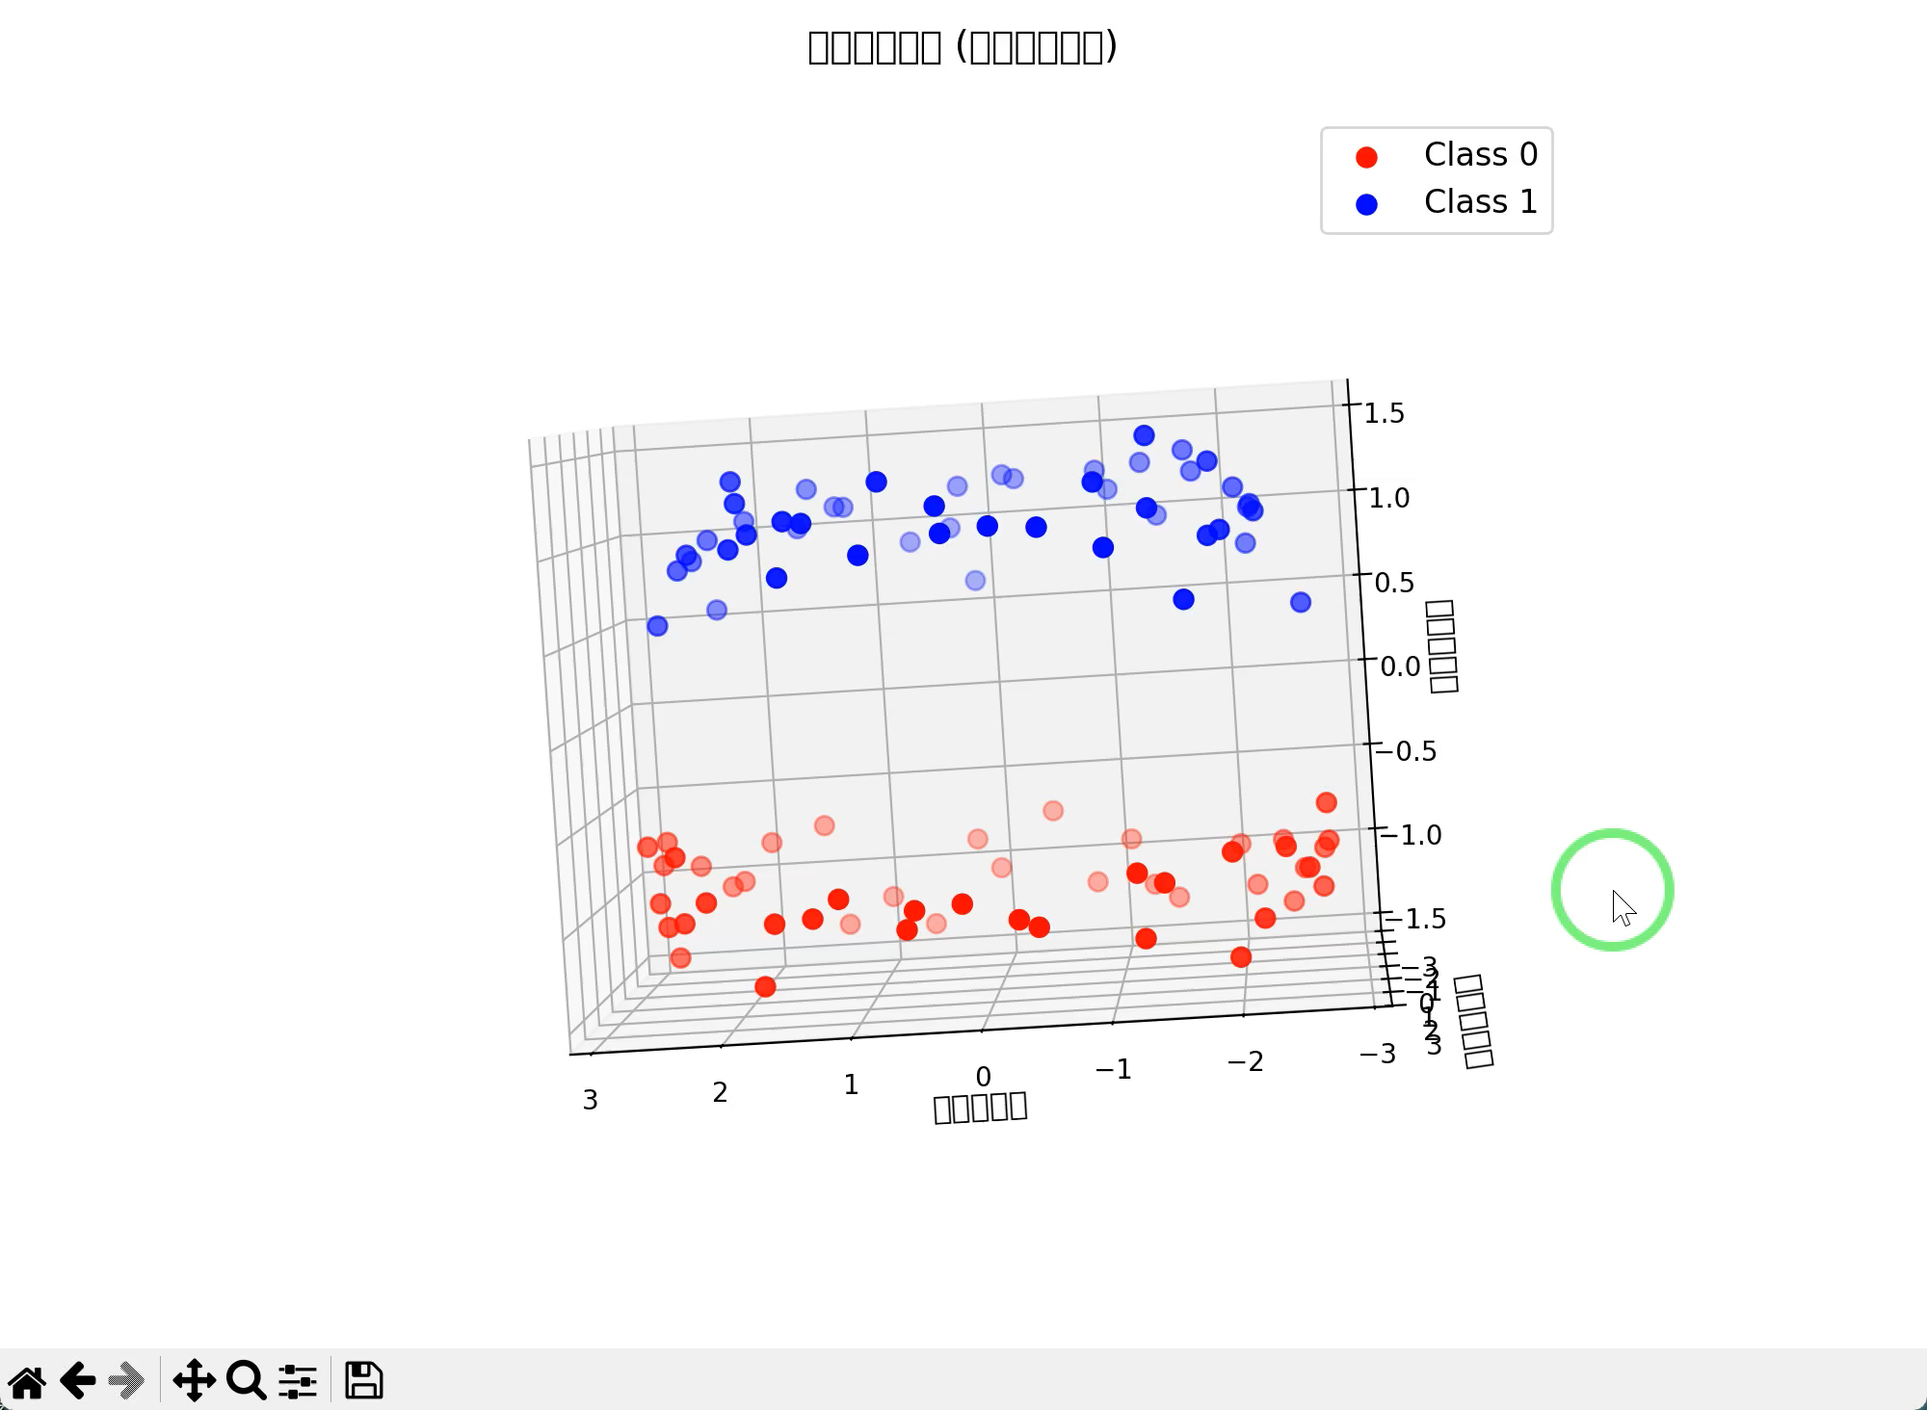
Create rotation plot for slide 17 in SVM.

Slide 4
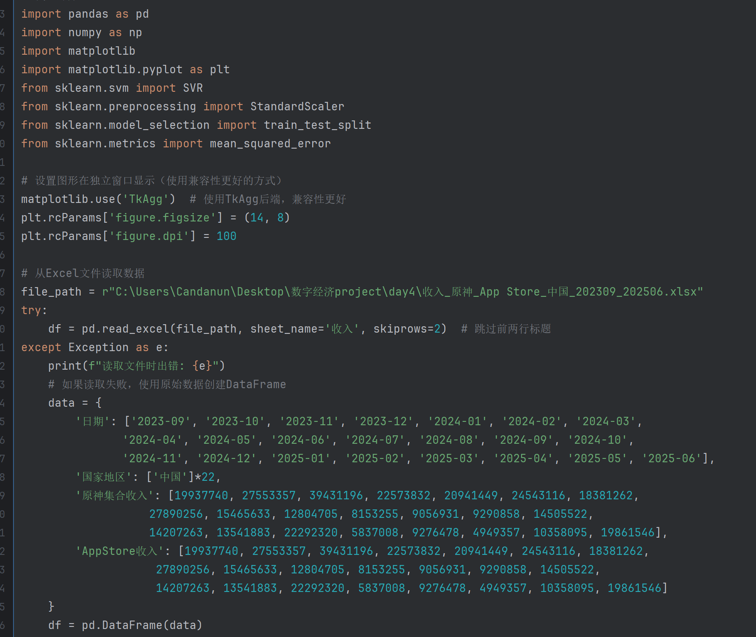
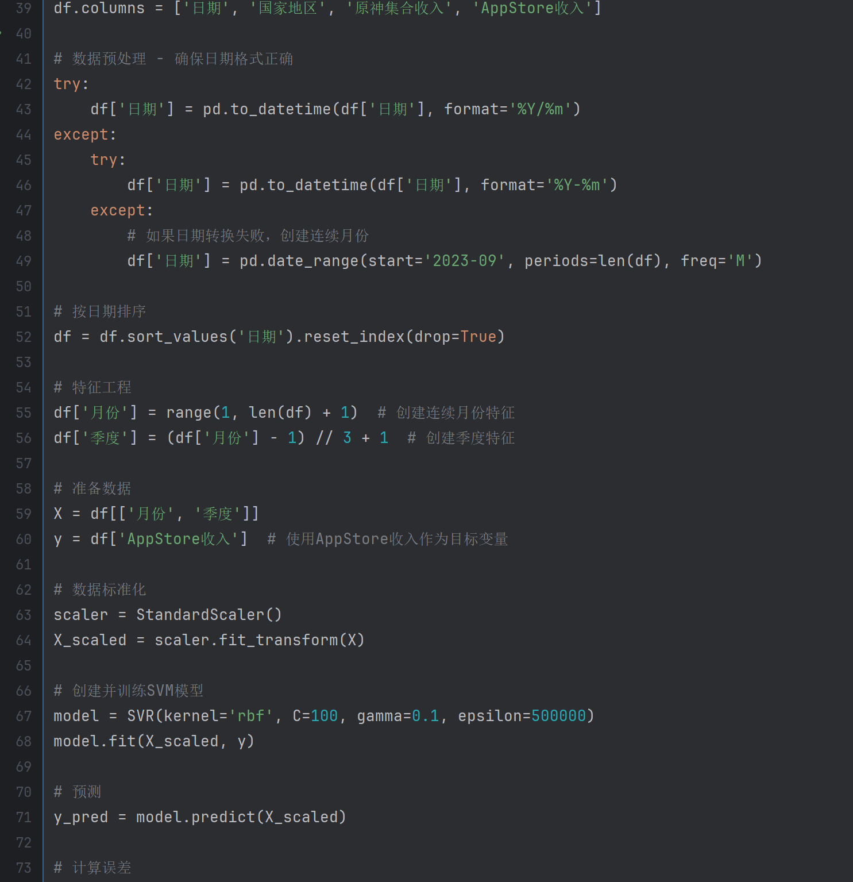
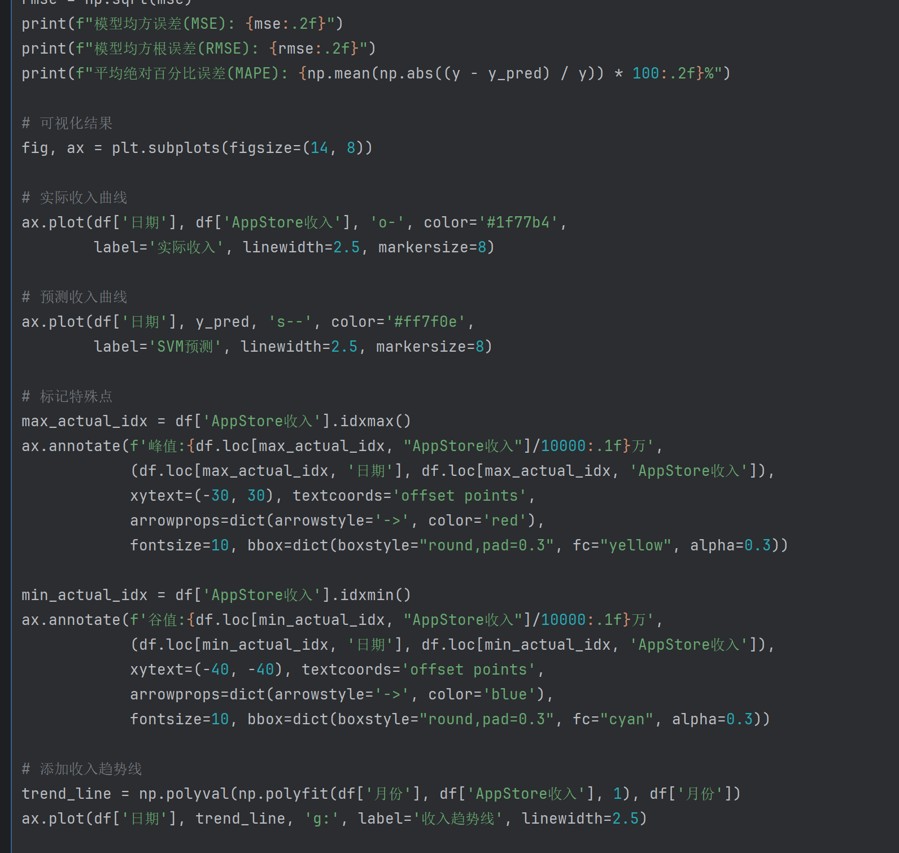
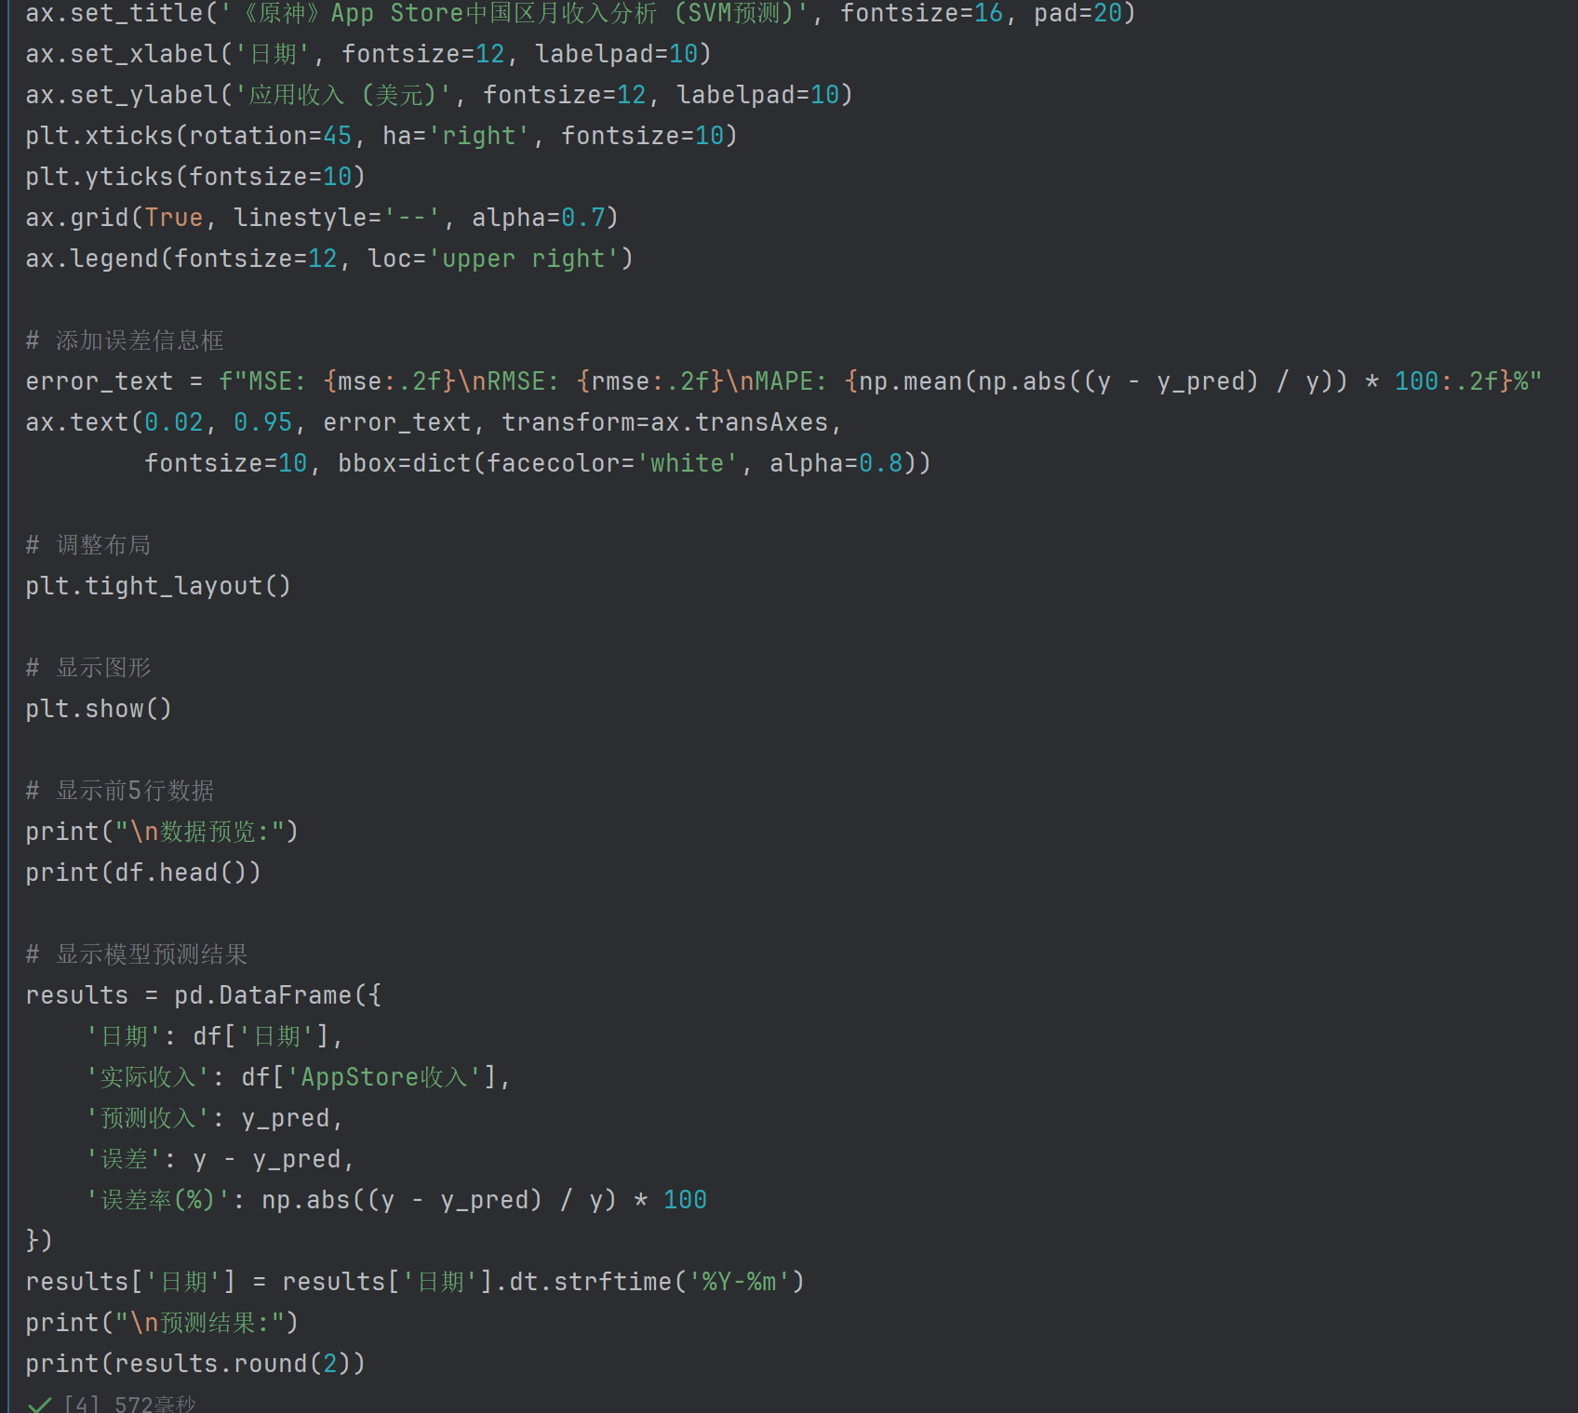
2. Do SVM on your data of choice.

Slide 5
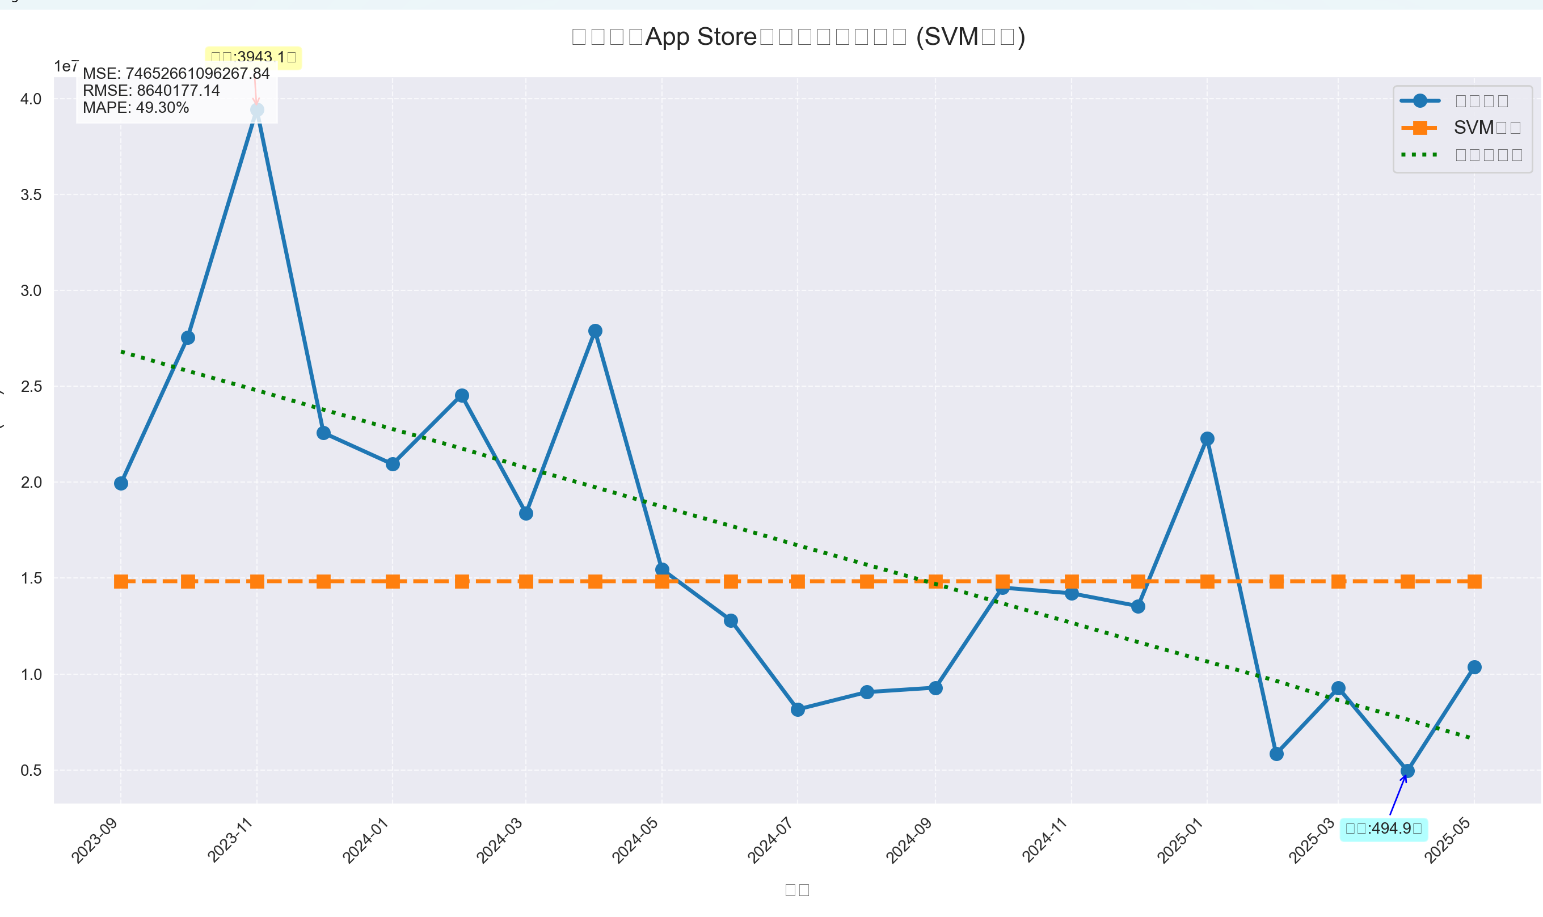
2. Do SVM on your data of choice.

Slide 6
Thanks And Your Slogan Here

